Slide 1
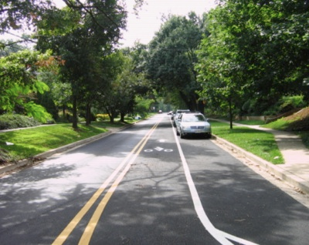
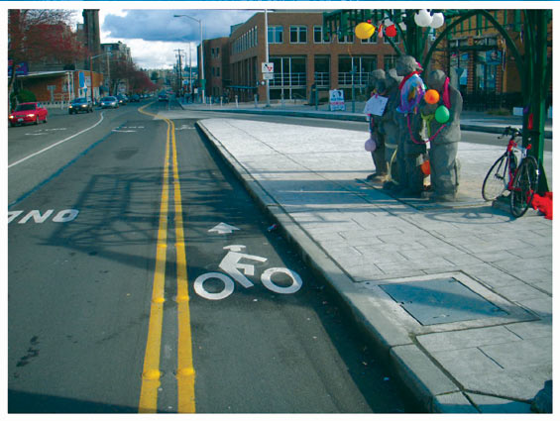
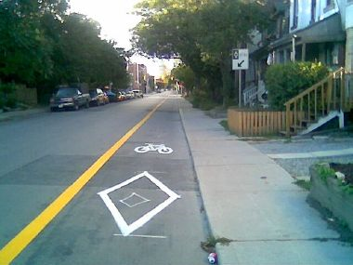
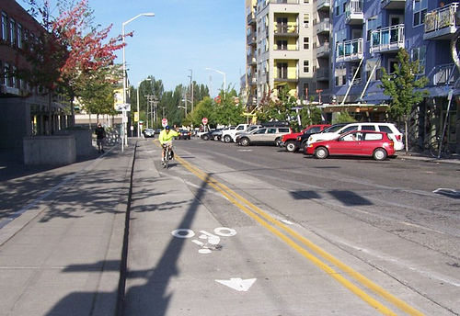
Counter-Flow Bike Lanes

Slide 2
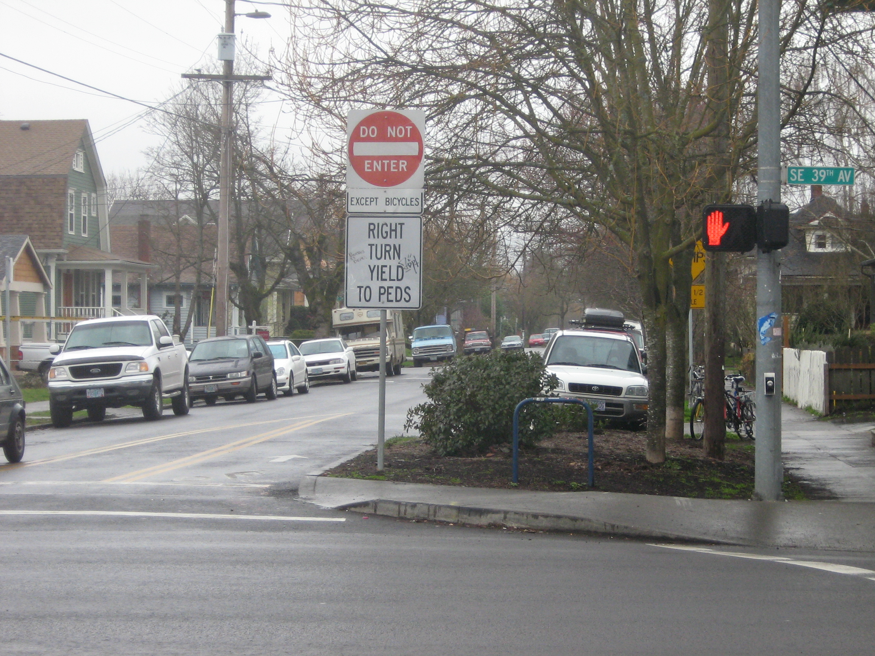
Counterflow Bike Lanes (Portland)

Slide 3
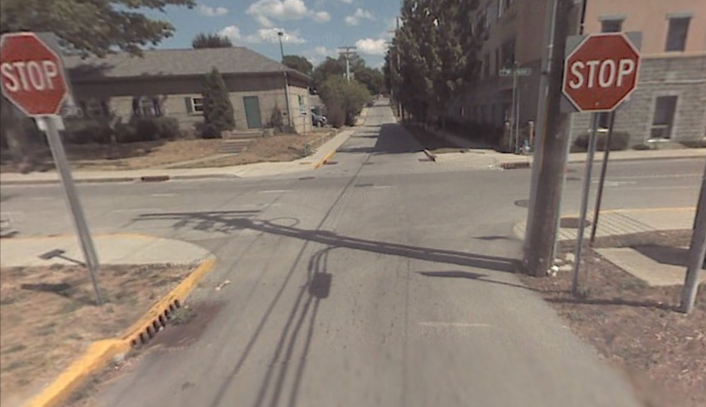
Washington & Smith Ave

Slide 4
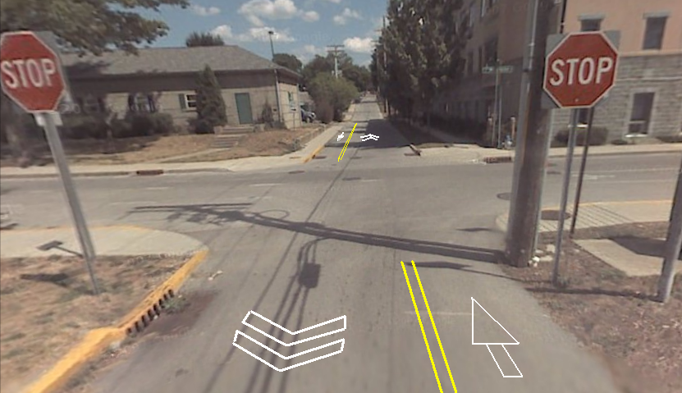
Counterflow Bike Lanes

Slide 5

Counterflow with Two-way

Slide 6
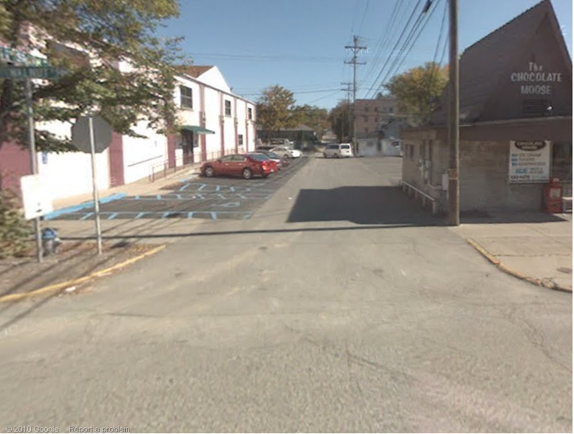
Walnut & Smith Ave

Slide 7
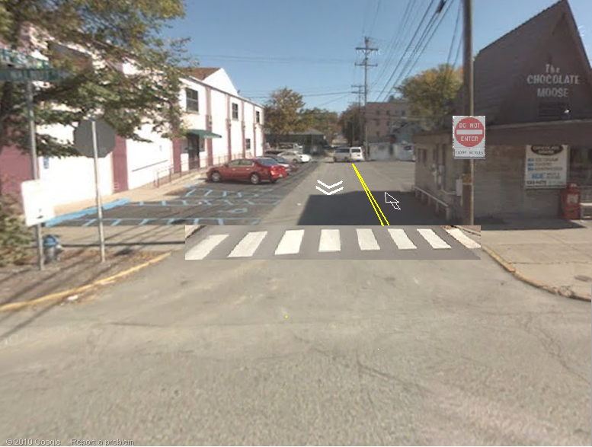
Counterflow Bike Lane and Xwalk

Slide 8
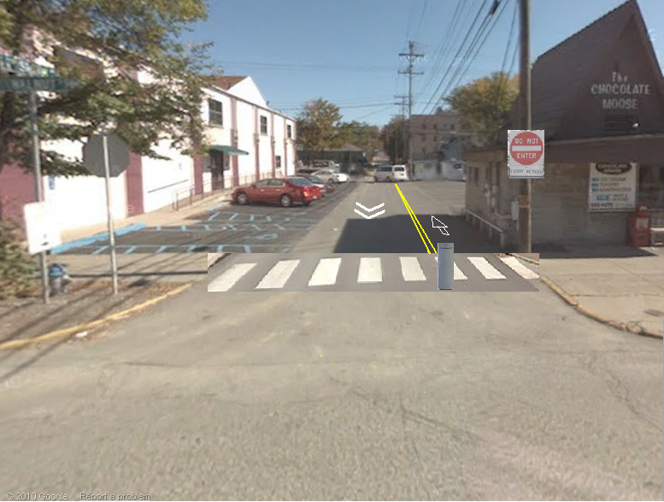
With Bollard

Slide 9
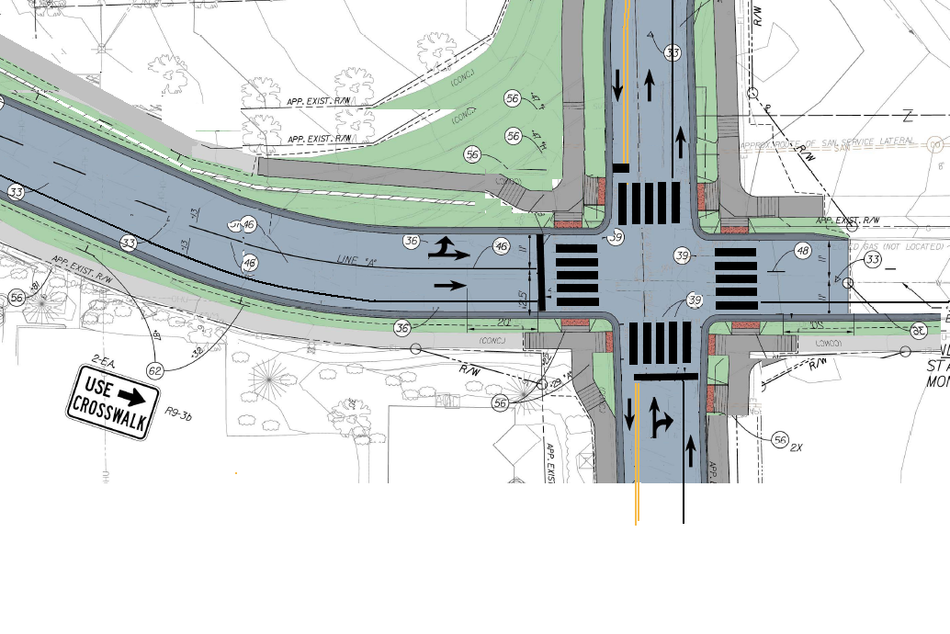
Bike lanes, including counter-flow bike-only lane, on Henderson (single lane for cars)
Notes:
Put in bike lanes on Henderson; single car lane with counterflow bike-only lane.

